Slide 1
Cell Organelles: Endoplasmic Reticulum, Golgi Complex, Lysosomes, Peroxisomes
Lecture 15

Slide 2
Objectives
Describe the structure, types and functions of endoplasmic reticulum (ER)
Describe the role of ER in detoxification process and processing of proteins
Compare between rough and smooth ER
Describe the structure and function of Golgi complex
Explain how Golgi complex acts as a “Traffic Director” of cellular proteins
Describe the structure, activation process, and function of lysosomes
Describe the function and origin of peroxisomes

Slide 3
Endoplasmic Reticulum (ER)
endoplasmic "within the cytoplasm”; reticulum "a little net"
continuous network of flattened sacs, tubules, and associated vesicles enclosed by closely apposed (parallel) membranes
the sacs are called cisternae (cisterns)
the space within called the lumen
the ER is continuous with the outer nuclear membrane
the area of the ER membrane is 50-90% of all the membranes of the cell
Two types of ER
rough ER
smooth ER

Slide 4
Rough ER
Cytosolic (not lumenal) side of the ER membrane is studded with ribosomes: origin of "rough" ER naming
Ribosomes synthesize polypeptides (proteins) & can dock to ER membrane when the protein is fated to be exported from cell or embedded in membrane
Nascent polypeptides thread into ER lumen during synthesis; later they vesiculate from ER to travel to Golgi before heading to cell surface

Slide 5
Rough ER (RER) Facts
RER ribosomes make all proteins fated to be secreted or embedded in a membranous part of cell: plasma membrane, lysosome
RER is well-developed/abundant in cells with functions to make secretory proteins
antibody-producing plasma cells
hepatocytes making plasma proteins
The cell's plasma membrane components have origin in ER: all integral proteins and phosphoplipids arise from it
Lipid synthesis enzymes for making membrane lipids are present on cytosolic side of ER membranes

Slide 6
Smooth ER (SER)
When present in cells, smooth ER is continuous with rough ER
Cell types with extensive SER and why:
Cells making steroid hormones cells in ovary & testes & adrenal cortex make steroids from cholesterol, which is a very lipophilic molecule
the SER provides chemical environment for the kind of enzymes requiring a water-free microenvironment to perform these reactions
Liver cells (hepatocytes) storing glycogen the liver regulates blood glucose levels by breaking down glycogen to glucose and releasing glucose to blood
the SER features the enzyme glucose-6-phosphatase, which catalyzes the reaction below so that glucose can exit the cell (remember that the enzyme hexokinase phosphorylates glucose to traps it into cells after entry)
glucose-6-phosphate + H₂O → glucose + P_{i} (P_{i} = H₂PO₄–)

Slide 7
Smooth ER (SER)
Muscle cells using calcium (Ca²⁺)
The sarcoplasmic reticulum (SR) is a special form of the ER in muscle cells largely used as a store of Ca²⁺ ion
Ca²⁺ is required as part of the interaction of the proteins myosin and actin in muscle contraction, and it must be removed quickly when muscle is to be relaxed The SR membrane has many Ca²⁺ ATPase pumps to pump Ca²⁺ out of the cytosol and into the lumen of the SR
Note: when contraction is desired, the Ca²⁺ ions—at a high concentration in the SR lumen—are released into the cytosol of muscle cells by voltage changes by depolarization in the SR membranes, which open voltage-dependent Ca²⁺ transmembrane channel proteins to allow Ca²⁺ to rush into the cytosol

Slide 8
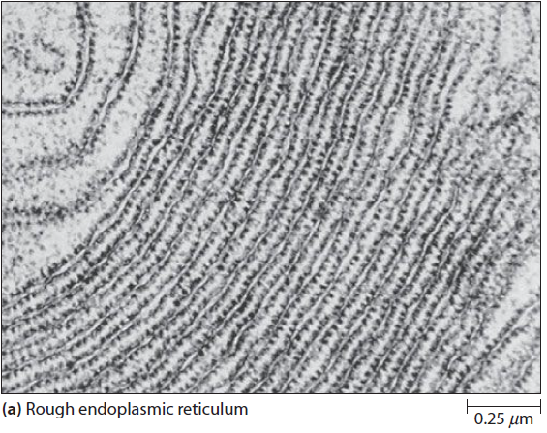
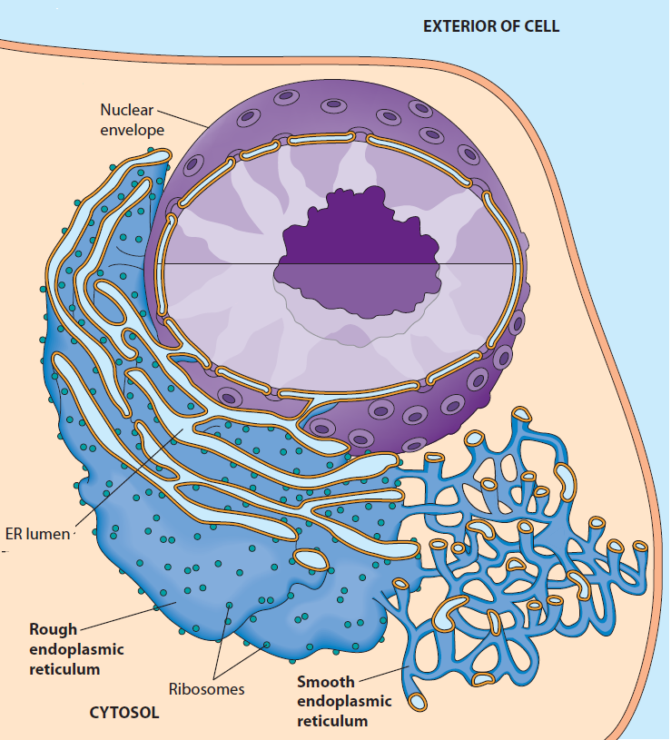
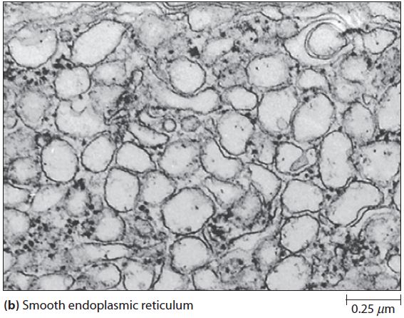

Slide 9
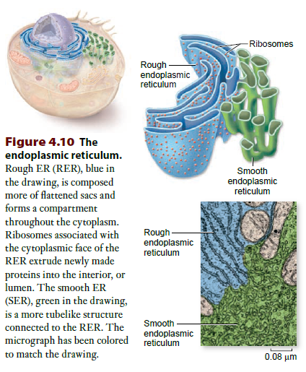

Slide 10
Smooth ER In Detoxification
The SER provides the proper chemical/catalytic environment for a group of enzymes known as cytochrome P450 mono-oxygenases
Many toxic compounds that enter the body through inhalation by lungs, ingestion through intestine, and by dermal absorption are highly lipophilic (nonpolar, hydrophobic)
The P450 enzymes get these toxicants (which can also be drugs) into their active site, and they create the equivalent of a chemical bomb to alter their unreactive chemical structure
This "chemical bomb" is a reactive oxygen species (ROS) that reacts with everything, but the enzyme tries to create the reaction so that the ROS hits the toxic chemical first
Sometimes the P450 enzyme is itself destroyed by the ROS product it forms in the active site & sometimes the ROS gets away without reacting, requiring the ROS to be taken out by other enzymes (see peroxisome slide explanation)

Slide 11
SER: Biotransformation 1 of 3
The Cytochrome P450 (CYP) reaction is:
RH + NADH/NADPH + H⁺ + O₂ → ROH + NAD/NADP+ + H₂O
The RH (toxicant, drug) is usually a very hydrophobic (lipophilic) molecule
Cellular biochemistry prefers an aqueous environment: it doesn't prefer hydrophobic molecules, so the P450 systems tries to make lipophilic substances like toxicants and drugs polar with its reactions
To make polar what is nonpolar typically involves oxygenating a molecule
recall that O and N atoms create polarity in covalent bonds as they are the most electronegative of the atoms
the product is hydroxylated (a relatively lipophilic C–H bond will be converted to a polar covalent C–OH bond)

Slide 12
SER: Biotransformation 2 of 3
All cells in the body have some ability to deal with toxic substances that enter them
Hepatocytes in the liver have a huge array of enzymes in the SER that detoxify these substances
Phase I Biotransformation
These are enzymes that fall into THREE classes
hydrolases: they add water to chemical groups with the purpose of creating –OH groups (increasing polarity & reducing lipophlicity)
reductases: they usually react with relatively not-as-polar carbonyl (C=O) groups, like aldehydes & ketones, and try to reduce them to a-bit-more-polar alcohols (–OH groups)
oxygenases: this is the class in which P450 enzymes fall, which try to put –OH groups using reactive oxygen species on very lipophlic substances
mono-oxygenase (P450) enzyme reaction
RH + (NADH or NADPH) + H⁺ + O₂ → ROH + (NAD⁺ or NADP⁺) + H₂O

Slide 13
SER: Biotransformation 3 of 3
Phase II Biotransformation
This process is often called conjugation, because a chemical group is conjugated to the toxicant/drug/poison
The Phase II enzymes attach the chemical group usually to an –OH group that was probably put there by Phase I enzymes or which already existed
glucuronidation
a glucuronic acid is put on the –OH group
glucuronic acid=glucose with number 6 carbon as a —COO– group on it, makes it negatively charged
sulfation
—SO₄^{2–} group put on the –OH group makes it negatively charged
methylation
acetylation
The conjugated group increases the polarity even more (even making it ionic in some cases) and helps to mark or tag the toxicant for excretion by urine or through bile typically

Slide 14
ER-Synthesized Polypeptides
After synthesis in the rough ER, protein goes into vesicles budding off the ER
Vesicles are guided through the cytoplasm by microtubules
microtubules are filamentous proteins acting like "cellular cables"
Vesicles fuse with the cis face of the Golgi complex
Complete proteins go into vesicles membranes or inner space, budding off the trans face of the Golgi to their final site depending on protein funciton
Secretory proteins enter the vesicle space, with vesicles moving to contact plasma membrane
Exocytosis usually occurs in response to event/signal

Slide 15
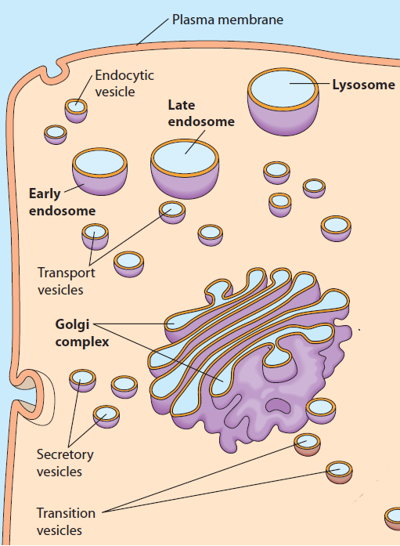
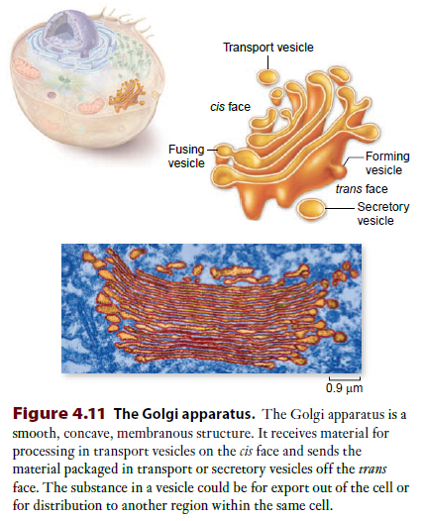
Transition vesicles bud off from ER and fuse to the cis-Golgi network (cis face)
Within the Golgi, vesicles bud off and fuse to other Golgi sacs in moving from trans to cis face of Golgi
Enzymes in Golgi modify particularly the oligosaccharide molecules of glycoproteins on the membrane.

Slide 16
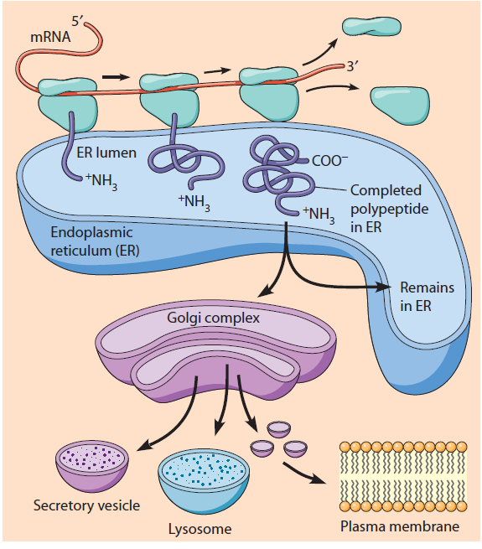
Although we have not covered protein synthesis yet (shown in top of illustration), polypeptides formed in the ER (not cytosol) will be in the lumen of ER and will move (by vesicles) from Golgi and ultimately to secretory vesicles, lysosomes, or to the cell surface on the plasma membrane

Slide 17
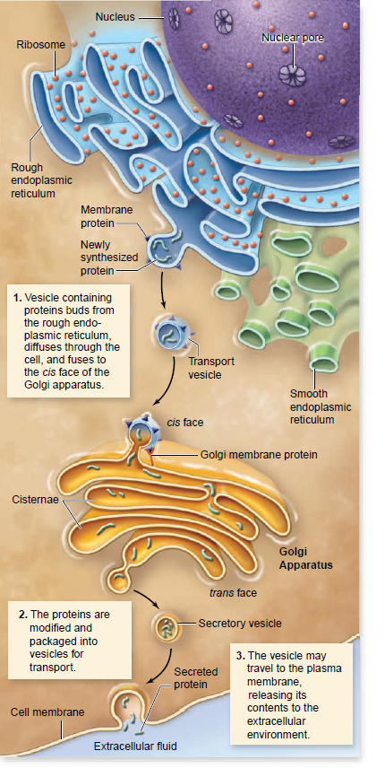

Slide 18
Golgi Complex (Golgi Apparatus)
Stacked and flattened membranous sacs (cisternae) with bulbous ends, associated with swarms of tiny vesicles
There are two "faces" or "sides" of the Golgi: cis and trans
The cis face receives vesicles with membrane and/or lumenal proteins made in RER
vesicles fuse to the cis face as they come from the ER
The trans face buds off vesicles that may move to the plasma membrane to fuse with it, or to become a membranous special endosome or organelle, such as a lysosome or parts of a peroxisome

Slide 19
Golgi Trafficking Models
Two models are proposed to explain how protein trafficks from cis to trans faces
Stationary cisternae the cisternae from cis to trans have a special set of enzymes that each perform a different function, and proteins move from cisternae to cisternae via shuttle vesicles
Cisternal maturation the cisternae move from cis to trans, changing the sets of enzymes within them during the transition to cause changes to the proteins they contain

Slide 20
Golgi Functions
Membrane proteins in particular get modified extensively in the Golgi
Oligosaccharides attached to membrane proteins in the ER to become glycoproteins will have those oligosaccharide molecules altered by enzymes in the Golgi
Some membrane proteins may have mannose molecules phosphorylated, designating these proteins to become part of lysosomes

Slide 21
Trafficking Fates 1 of 2
Vesicles budding off the trans Golgi have three fates
Constitutive secretion
The vesicle goes to the plasma membrane (PM) surface and fuses immediately, providing phospholipids and membrane proteins need on the PM
If there are lumenal proteins, they are expelled as needed into the extracellular space to be used
Regulated secretion
The vesicle often contains in its interior secretory substances that might be proteins and other molecules
It moves just inside the PM and waits for a signal to fuse with the PM and expel the contents by exocytosis

Slide 22
Trafficking Fates 2 of 2
Lysosomal formation The vesicle is to become a lysosome, and has special digestive or degradative proteins contained within its interior that will be activated at the appropriate time it is fused with a vesicle that was created by any of the forms of endocytosis (phagocytosis, pinocytosis, receptor-mediated endocytosis) already discussed The lysosome also has H⁺-ATPases membrane proteins in particular, which are to pump protons into its interior when activated

Slide 23
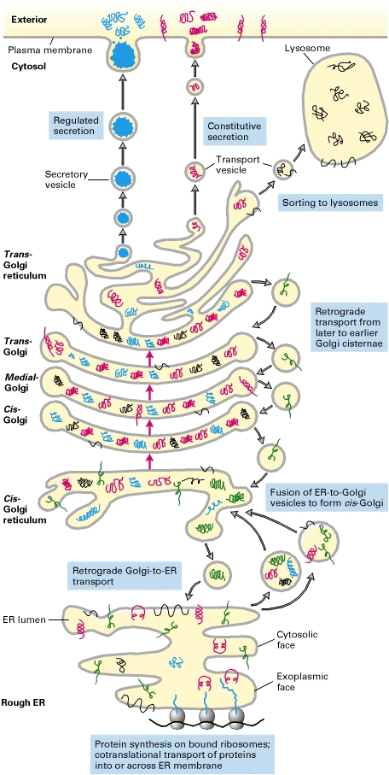
This figure nicely shows how vesicles coming off the trans-Golgi face can move towards 3 distinctive pathways:
constitutive secretion: the vesicles move immediately from the Golgi to the plasma membrane (PM), fuse with it, and allow their membrane to become part of the PM, thus replenishing the PM with phospholipids and membrane proteins it needs; there may also be contents in the vesicle exocytically expelled
regulated secretion: vesicles move from Golgi to just next to the PM. Then a signal occurs that usually causes voltage- or ligand-gated Ca²⁺-channels to open, Ca²⁺ rushes in, and the vesicles fuses and expels its contents exocytically
lysosomal formation: these vesicles remain in the cytoplasm and will fuse with phagosomes or other endosomes formed form surface, acidifying the contents and activating digestive enzymes, absorbing the breakdown products

Slide 24
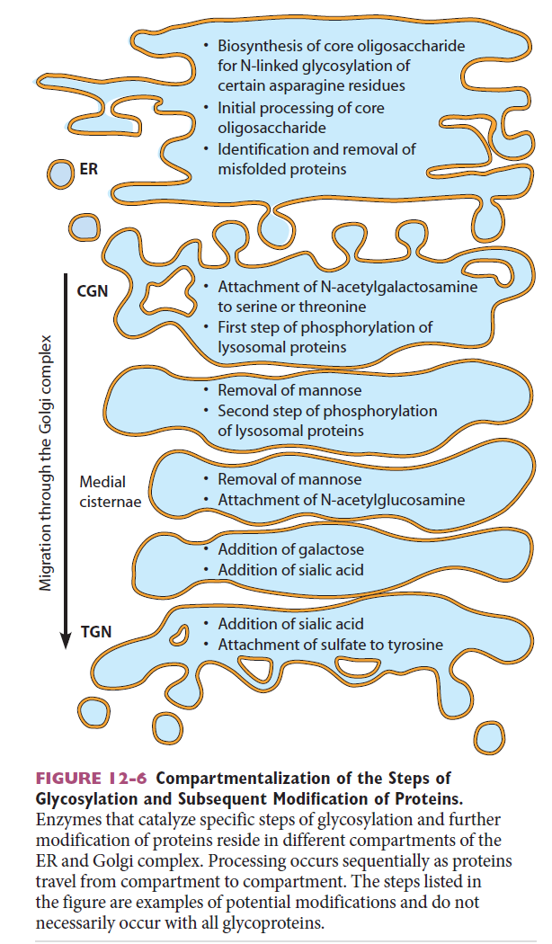
This figure shows details of what biochemical processes occur in the Golgi complex from the cis to the trans face in the maturation of many different types of proteins (particularly glycoproteins) that are fated to be on the plasma membrane or into lysosomes

Slide 25
Glycoprotein Formation
The initial glycosylation of a glycoprotein with its oligosaccharide(s) first occurs within the lumen of the RER
This initial glycoprotein proceeds to the Golgi: within the Golgi, the oligosaccharide is set upon with enzymes that add more sugar monosaccharides and modify others. These modifications are often to oxidize the terminal monosaccharides of the oligosaccharide that turn it into a negatively charged acidic form, or to put other unusual sugar monosaccharides on the glycoprotein
As the glycoprotein moves through the Golgi, the oligosaccharide that is modified signals which enzymes are to modify it further to make the glycoprotein have a functional form

Slide 26
Lysosomes
Born as “endosomes” which contain inactive enzymes, lysosomes (“disintegrator bodies”) are spherical membranous organelles containing digestive enzymes
Lysosomes are large and abundant in phagocytes, immune defense cells that dispose of invading bacteria and cell debris
Lysosomal enzymes can digest almost all kinds of biological molecules. They work best in acidic conditions, and their digestive enzymes are called acid hydrolases
The lysosomal membrane is adapted to serve lysosomal functions in two important ways:
It contains H⁺ (proton) “pumps” membrane proteins, which are ATPases (use energy) that gather hydrogen ions from the surrounding cytosol to maintain the organelle’s interior acidic pH
The membrane retains the acid hydrolases while permitting the final products of digestion to escape so that they can be used by the cell or excreted. In this way, lysosomes provide sites where digestion can proceed safely within a cell.

Slide 27
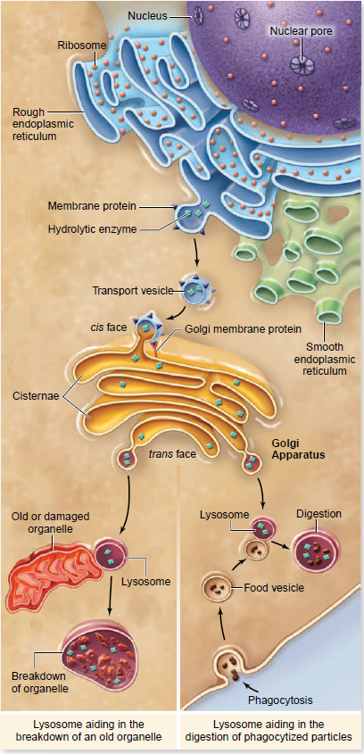
Yet another visual showing the endomembrane system and relationships of the ER, Golgi, plasma membrane, and the vesicles that form and fuse between these cytological structures

Slide 28
Lysosomal Mechanism
Primary lysosomes emerge from the trans Golgi, and lie dormant until activated
They are activated by merging with a heterophagic or autophagic vesicles
This triggers a proton (H⁺) pump, which acidifies the lysosomal contents
Acidification activates proenzymes to change to active enzymes: a pH =5 is about optimal for these enzymes
Lysosomal enzymes include proteases, amylases, and lipases, which digest the major biomolecular classes: proteins, carbohydrates, lipids
After digestion, indigestible material may or may not be expelled by exocytosis

Slide 29
Lysosomal Activities
Heterophagy
Cellular nutrition, metabolic functions, such as glycogen breakdown and release
Defense: killing bacterial invaders, or removing foreign particles
Autophagy
Cleaning up and recycling old worn-out organelles
Autolysis = cellular suicide
Apoptosis: removal of unwanted cells and tissues during fetal development (such as the webs between the fingers and toes of a developing fetus)
Extracellular digestion – special lysosome formation releases active enzymes by exocytosis:
Acrosome on sperm cells which contains enzymes that break down the outer membrane of the ovum
Osteoclasts Breaking down bone to release calcium ions into the blood).

Slide 30
Peroxisomes
Usually spherical membranous sacs present in all eukaryotic cells but in large number in liver and kidney cells
Smaller than mitochondria but vary in size
Not entirely derived from the ER unlike other endomembrane organelles and structures
Peroxisomes were believed to increase their numbers by a fission process (bud & separate) not fully understood
Recent suggests that most new peroxisomes form by budding off of the endoplasmic reticulum via a special ER machinery that differs from that used for vesicles destined for modification in the Golgi apparatus

Slide 31
Peroxisome Functions 1 of 2
Peroxisome has its name because it deals with peroxides: such as hydrogen peroxide: H₂O₂
Hydrogen peroxide can dissociate to form hydroxyl free radicals (•OH), which are extremely chemically reactive with biomolecules like proteins (affecting function) or DNA (potentially causing mutagenesis)
It has the heme (iron/Fe²⁺)-containing enzyme catalase to detoxify H₂O₂
2 H₂O₂ → O₂ + 2 H₂O
It also has the Zn²⁺/Cu²⁺-containing enzyme superoxide dismutase (SOD) to eliminate the very reactive oxygen species, superoxide anion (O₂–)
2 O₂– + 2 H⁺ → H₂O₂ + O₂
Note that SOD produces H₂O₂, which must then be handled by catalase

Slide 32
Peroxisome Functions 2 of 2
Peroxisomes catabolize (break down) long chain fatty acids (more than 16 carbons) so that mitochondria can catabolize them further, in a process called beta (β)-oxidation
They also break down unusual amino acids (D-amino acids) and other nitrogen-containing compounds, using oxidative enzymes
They have oxidative enzymes to detoxify alcohol and aldehydes like formaldehyde & acetaldehyde
Why do peroxisomes generate these reactive oxygen species [ROS] (H₂O₂, superoxide anion)?
Notice the above processes use words like "oxidation"
Peroxisomes contain enzymes (oxidoreductases: oxidases, reductases, dehydrogenases) which utilize O₂ to perform catabolic metabolism
These enzymes often generate ROS purposely or adventitiously as part of the catalysis of trying to move 1 or 2 electrons in oxidation-reduction reactions

Slide 33
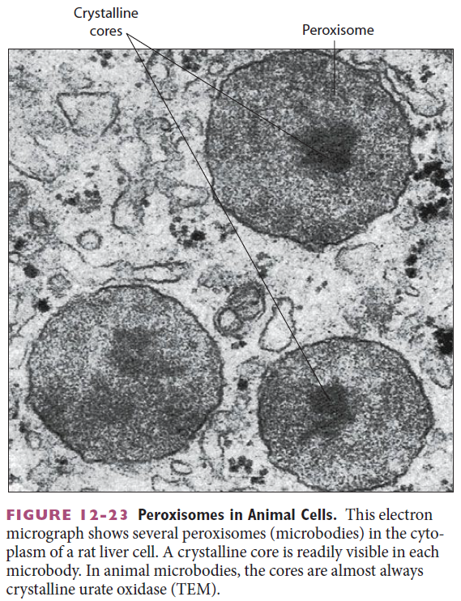
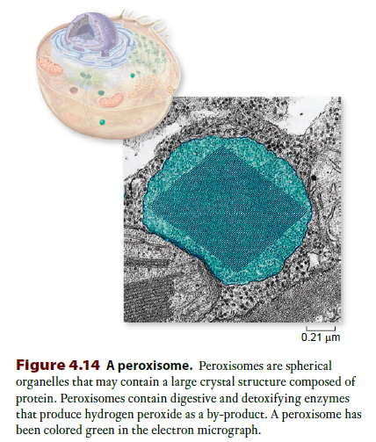

Slide 34
Reading (Sources)
Becker's WotC: pp 324-326, 330-341, 356-358
Raven: Chap 4.4: pp 69-72
Marieb: pp 68-71

